Slide 1
Indoors: On host premises: eg. School, College, University or other institution
F.A.S Covid-19 and Outreach Webinar
Image:G.James

Slide 2
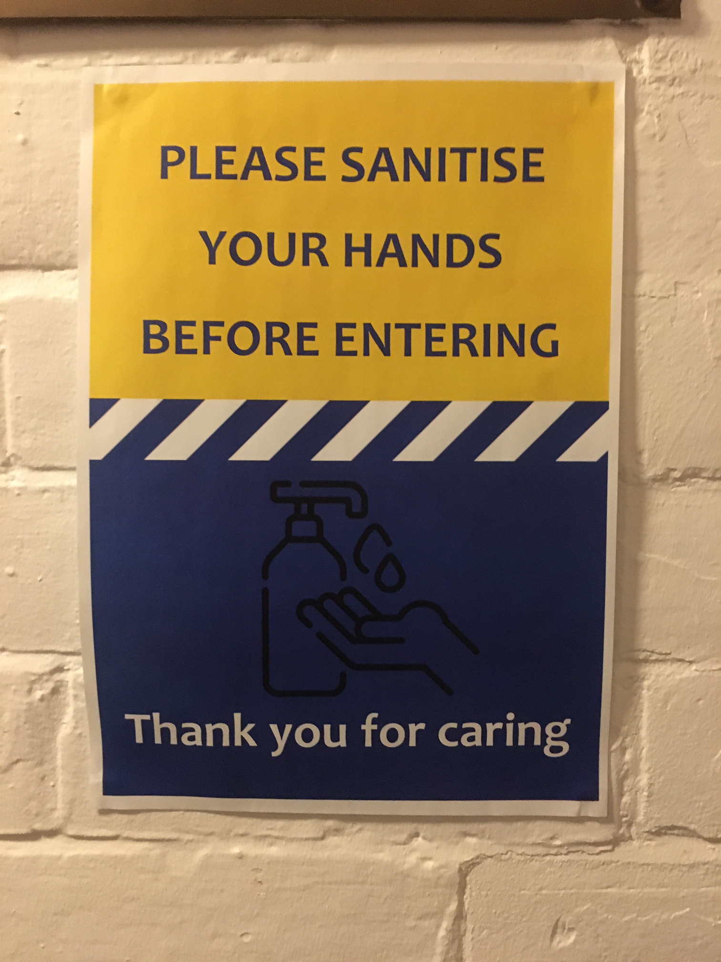
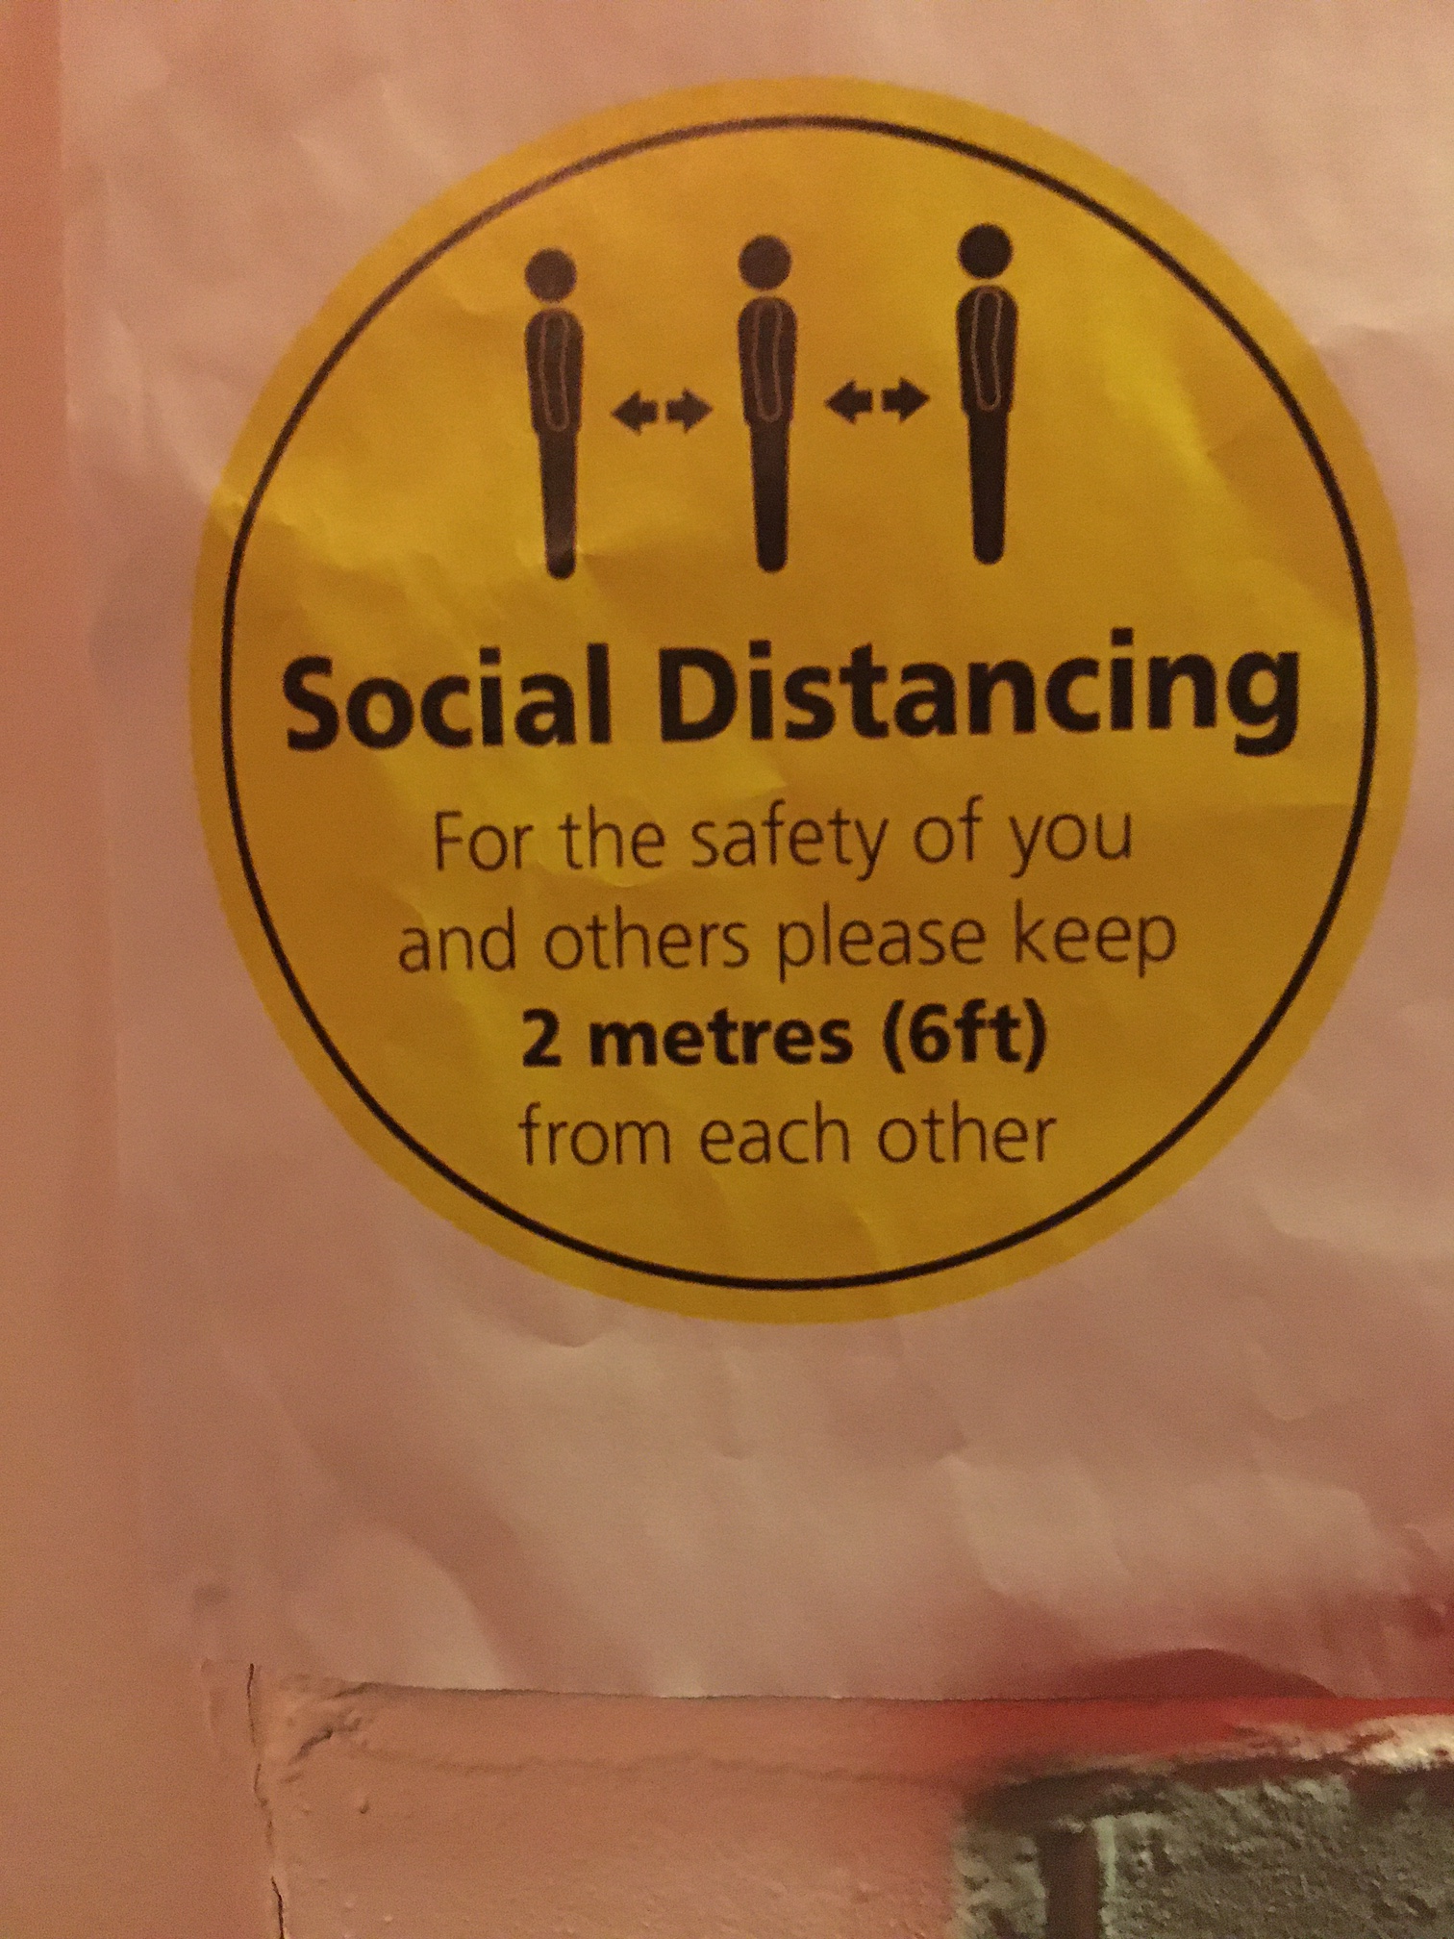
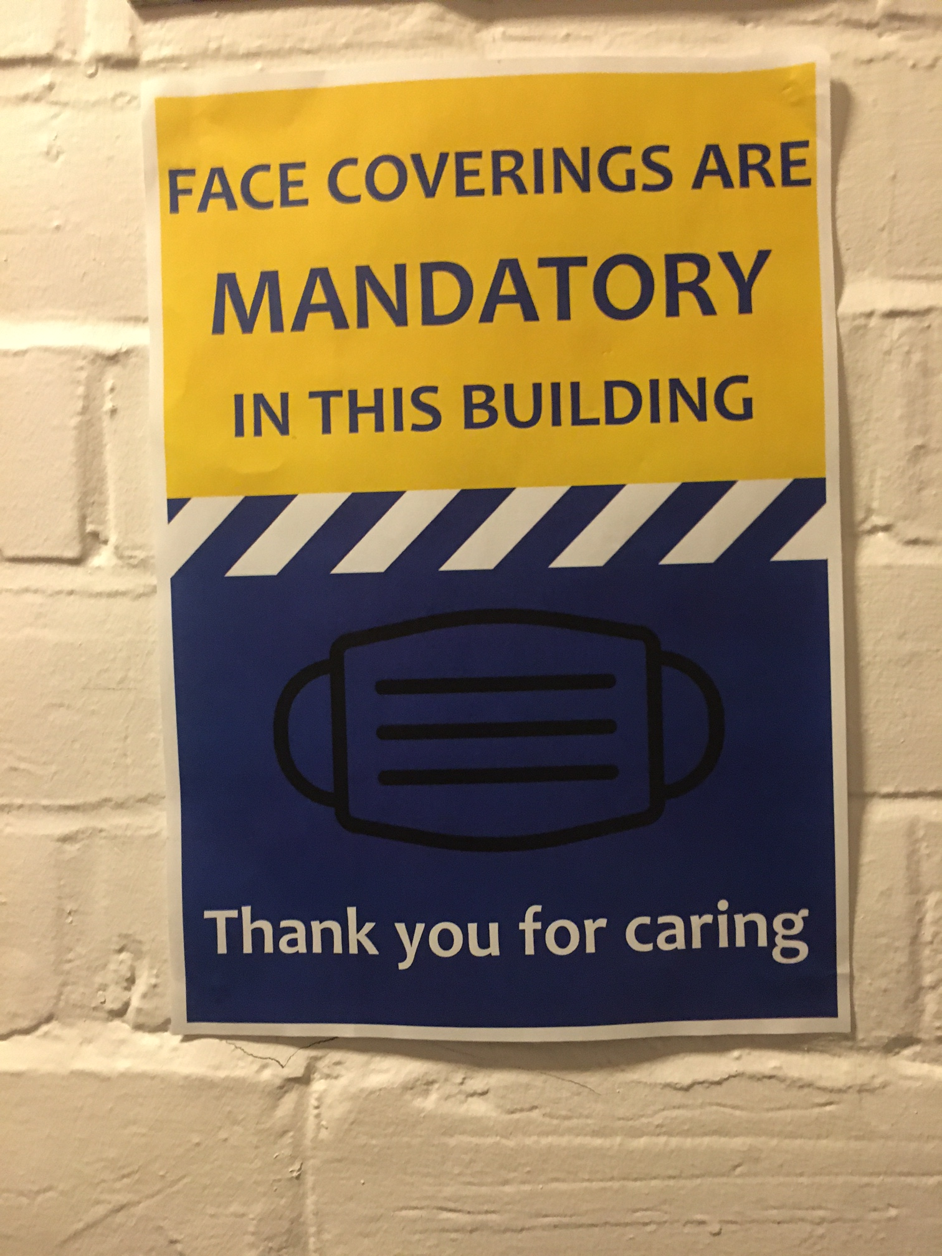
- Risk Assessment:
General (for the venue)
+ Covid-19 specific to the venue/event/group event/group
- Improve upon host venue’s rules
Venue must have
a) alcohol-based sanitizer for hands
b) clear signage re social distancing and enforcement of masks (and should have spares)
- You should have
a) own mask
b) own visor

Slide 3
Number control
a) venue restricts numbers
b) break into smaller (‘bubble’) groups
Social distancing
a) 2m+ between speaker and audience at all times
b) seating used to ensure 2m spacing maintained (unless venue operates otherwise) perhaps depending on ‘bubbles’ – this can significantly reduce normal capacity

Slide 4
Traffic flow
a) venue organize entry and exit routes to avoid contraflow
b) venue provides ‘marshals’ for flow
c) queues are avoided or monitored with SD
d) barriers/signage used and ideally a clear ‘route’

Slide 5
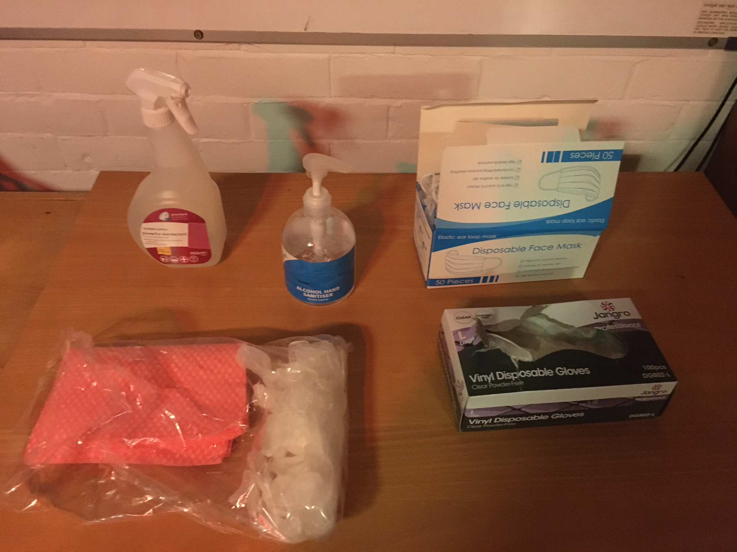
Cleaning
a) venue organizer ensures cleaning of venue before and after
b) venue host supervises cleaning of equipment especially high risk areas/objects during the event eg doors, chairs and stair rails.
c) outreach provider cleans their equipment before and after event

Slide 6
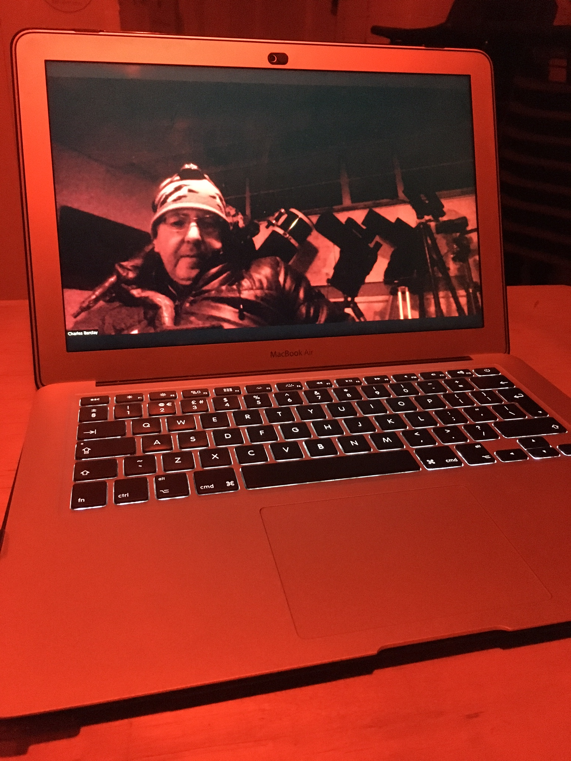
Questions?

